Slide 1
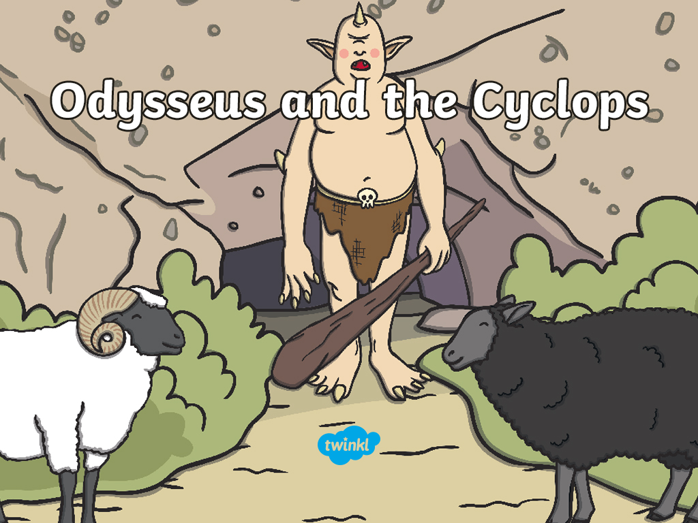

Slide 2
A long time ago, there was an island in Greece called Crete.

Slide 3
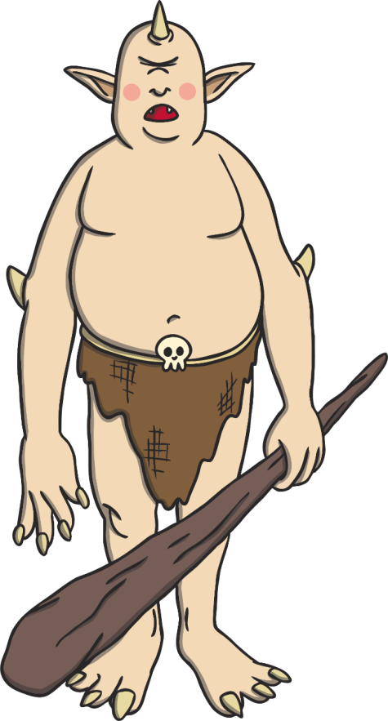
On the island, there lived Cyclops, who was as big as a house.

Slide 4
One day, a man called Odysseus and his 12 men came to the island.

Slide 5
They found a dark and gloomy cave.

Slide 6
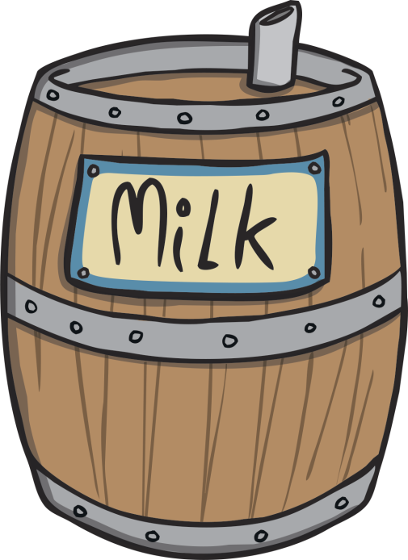
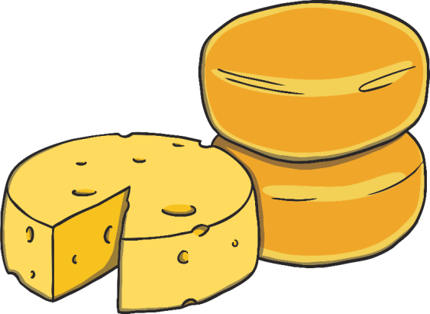
Inside the cave, they saw milk and cheese.

Slide 7
Cyclops came to the cave and was surprised to see the men inside.

Slide 8
He pushed a huge boulder across the entrance and trapped the men.

Slide 9
Odysseus gave Cyclops a drink of wine.

Slide 10
Cyclops fell fast asleep.

Slide 11
The men stabbed Cyclops in the eye.

Slide 12
The men tied themselves to the bottom of the sheep and
escaped from the cave.

Slide 13
The men escaped from the island and sailed away.

