Slide 1


History
Ancient Greece
Year One
History | UKS2 | Ancient Greece | Gods and Goddesses | Lesson 5

Slide 2
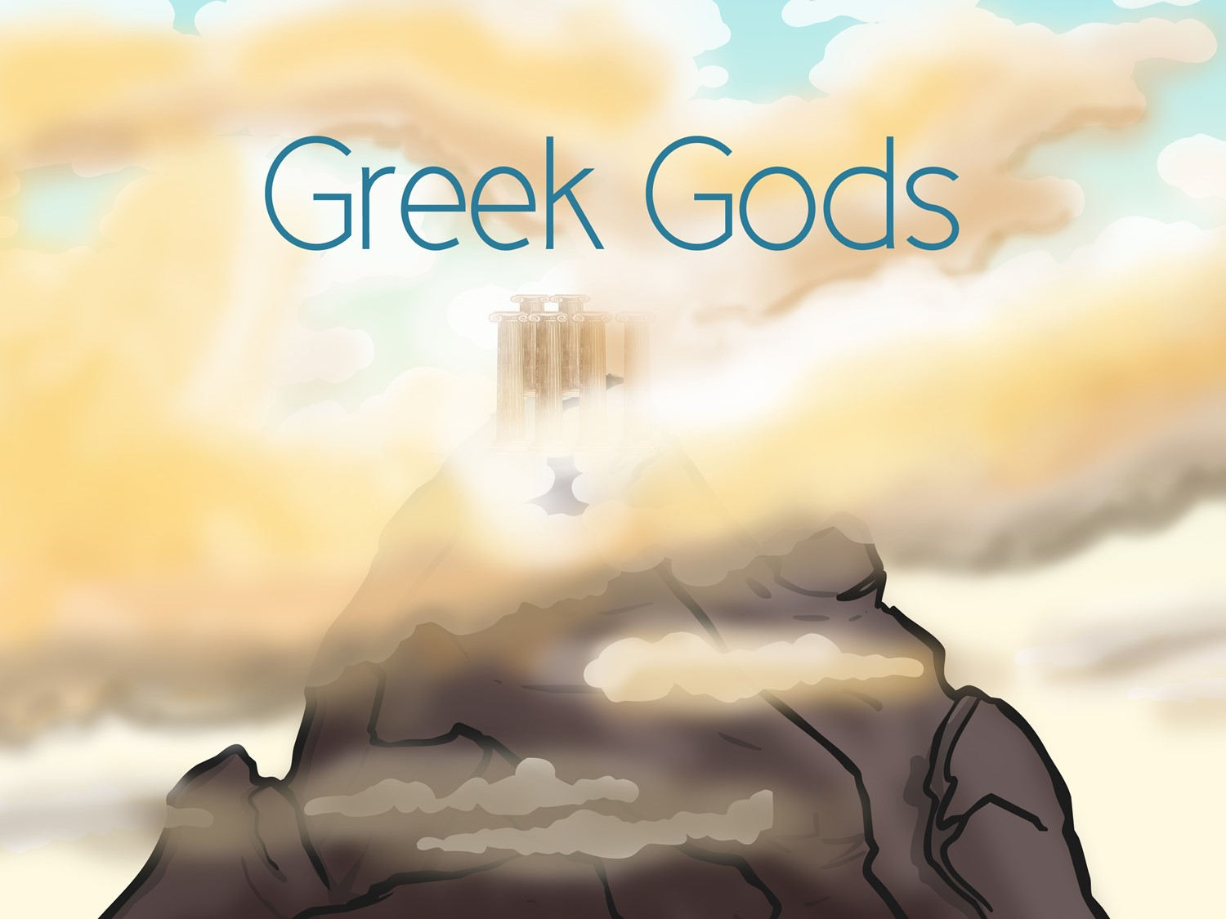


Slide 3
Aim
I can find out about Ancient Greek gods and goddesses and am able to use this knowledge to plan my own Greek myth
Success Criteria
I can research different Greek gods and say key facts about them
I can plan my own Greek myth, using gods, goddesses, monsters and heroes

Slide 4

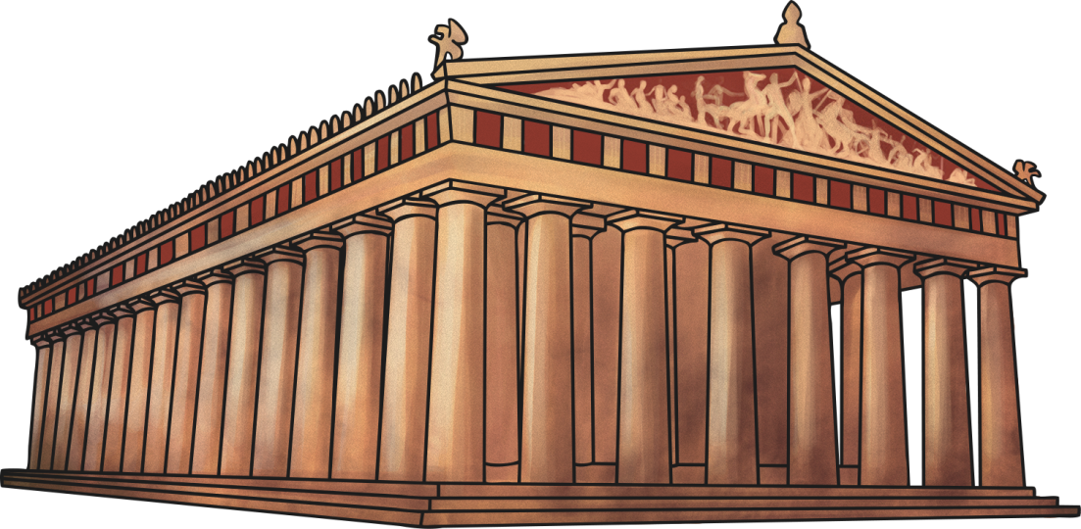
Ancient Greek Religion
The Ancient Greeks were a religious lot. They believed that their gods and goddesses controlled everything in the world and that they must be revered and appeased.
The Ancient Greek people built huge, beautiful temples and shrines where they could go to worship the gods.
They also held festivals in honour of the gods and people would pray and make offerings to them in hope of being granted good fortune in return.

Slide 5
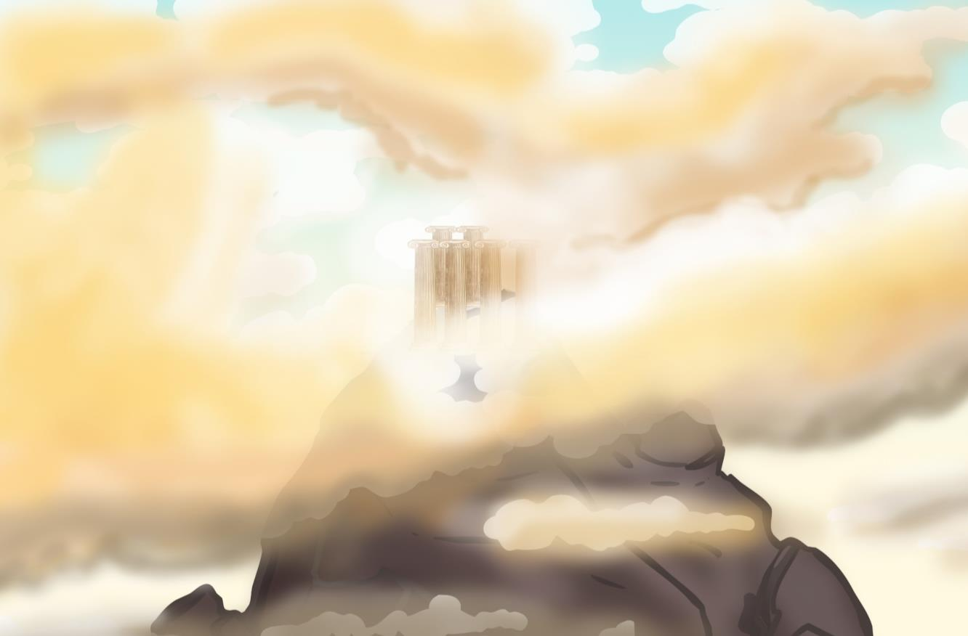
Mount Olympus
The Ancient Greeks believed that the twelve most powerful gods lived at the top of a huge mountain called Mount Olympus. However, some very important gods such as Hades; God of the Underworld, did not live there.
Mount Olympus was where the gods held meetings and disputes were settled.

Slide 6
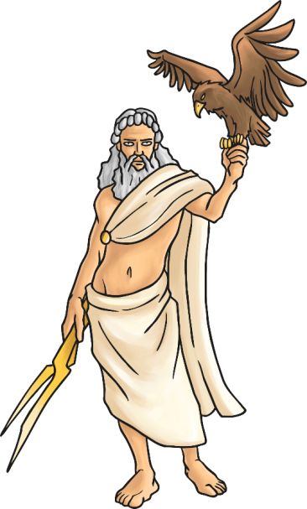
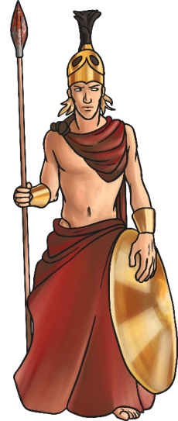
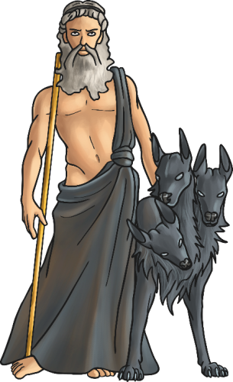
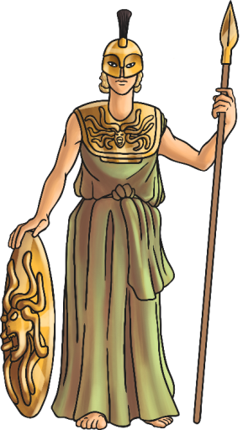
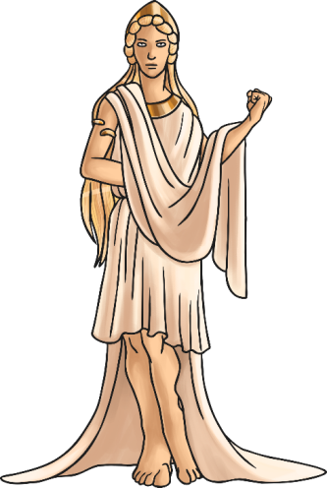
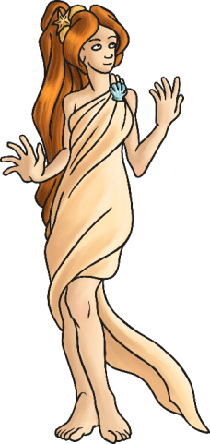
Greek Gods and Goddesses
We are going to learn some key facts about some of the main Ancient Greek gods and goddesses.
Try to remember what each god represents to the people and what their special weapons or objects are.

Slide 7

Zeus
Zeus was the most powerful of all the gods. He was the God of the Sky and the King of Mount Olympus.
He was married to the Queen of the Gods, Hera, but he had many other lovers.
His temper affected the weather, and when he was angry he threw thunderbolts.
Did you know?
Zeus’s father was worried that his children would betray him, so he ate them. Zeus’s mother tricked his father by giving him a rock to eat so Zeus was free.

Slide 8
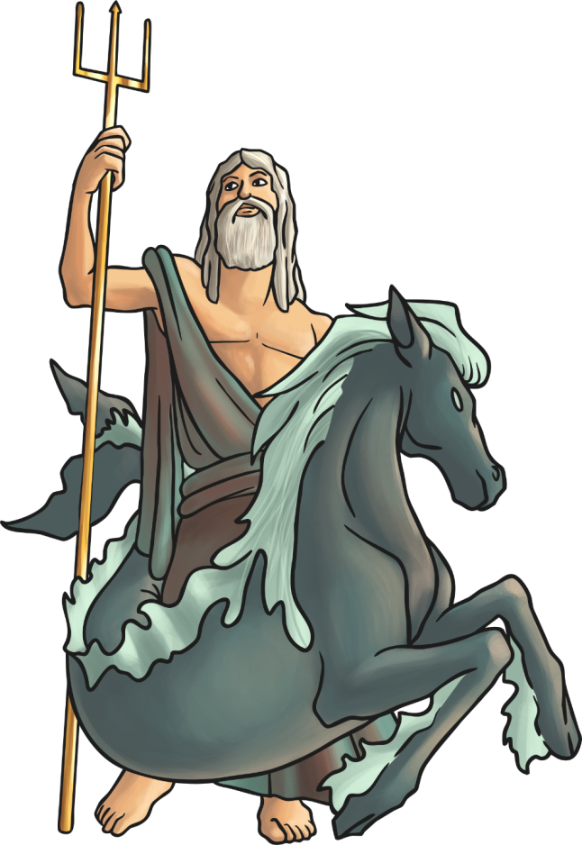
Poseidon
Poseidon was the God of the Sea. He was the most powerful god except for his brother, Zeus.
He lived in a beautiful palace under the sea and caused earthquakes when he was angry.
Poseidon delayed the return of the Odysseus from the Trojan War by causing his boat to be shipwrecked.
Did you know?
He rode a chariot pulled by seahorses.

Slide 9
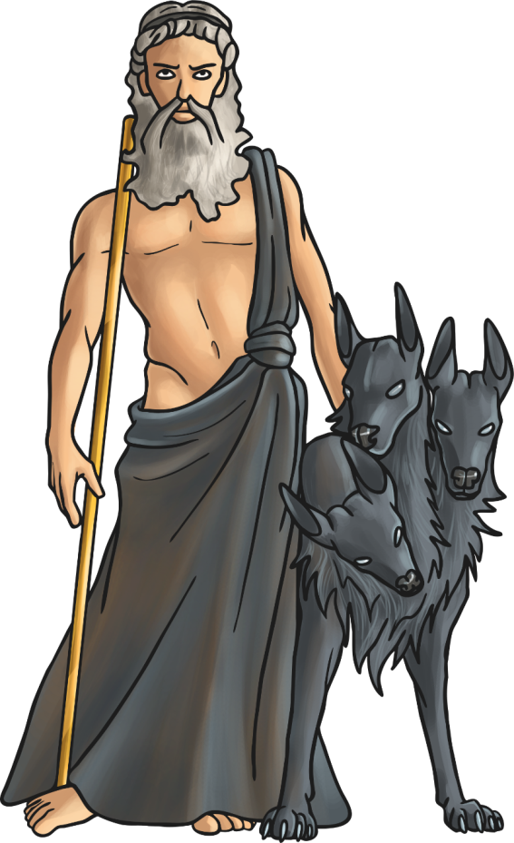
Hades
Hades is the brother of Zeus.
Hades was the God of the Dead. He ruled the underworld where people went when they died.
Ancient Greeks were quite afraid of him.
People sacrificed to Hades when they wanted something bad to happen.
Did you know?
He was also the God of Wealth because of the precious metals that were mined from the earth.

Slide 10

Hera
Hera is the sister and wife of Zeus.
She was powerful and beautiful but very jealous and vain.
Hera is an earth goddess and the goddess of family and marriage.
Greek men thought of her as unpleasant.
She tried to kill Zeus’s son, Hercules.
Did you know?
She was on the side of the Greeks in the Trojan War, but Zeus sided with the Trojans. She deceived and distracted her husband, so that the Greeks had the upper hand during the Trojan War.

Slide 11
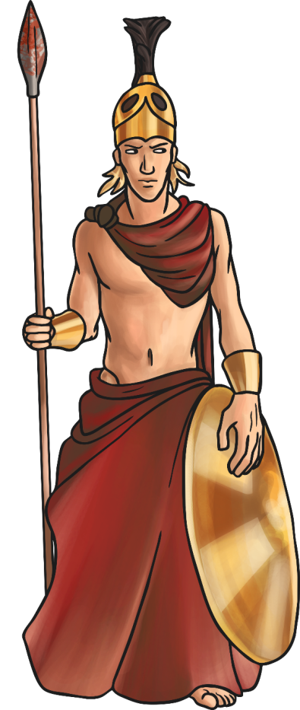
Ares
Ares was the God of War. He was both cruel and a coward.
Ares was the son of Zeus and Hera, but they did not like him.
He killed the giant Ekhidnades, a fierce monster and an enemy of the gods.
Did you know?
His throne was upholstered in human skin.

Slide 12
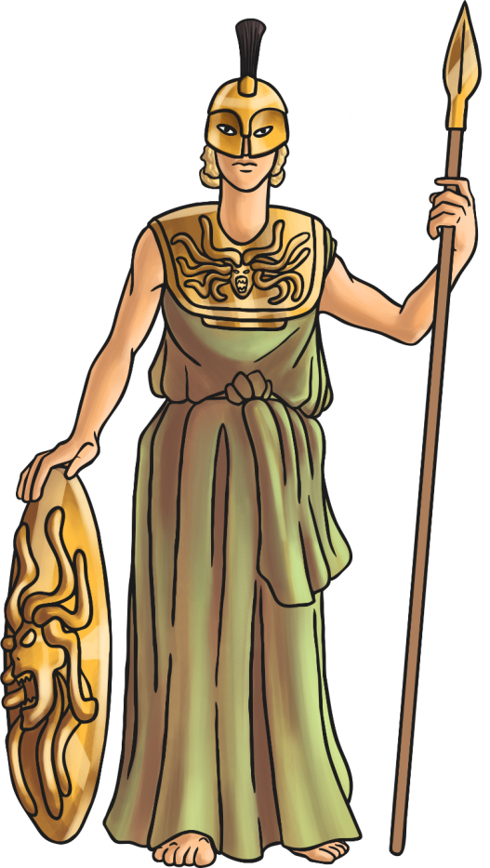
Athena
Athena is the daughter of Zeus. She was born directly out of his forehead.
She was Zeus’s favourite child.
She is the goddess of intelligence, art and literature.
Athena turned Medusa from a human into a monster.
Did you know?
The city of Athens is named after Athena. The Parthenon is her best known and best preserved temple.

Slide 13
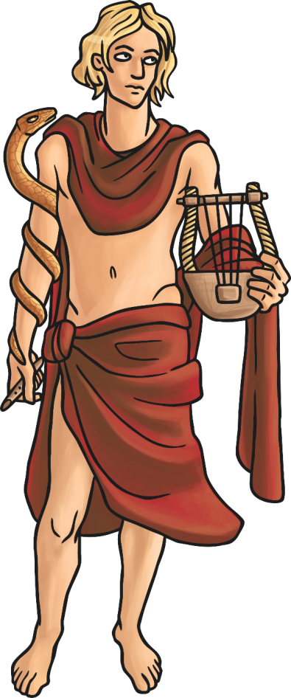
Apollo
Apollo is the son of Zeus and the twin brother of Artemis.
Apollo was the sun god. He was responsible for the movement of the sun across the sky. He moved the sun with a chariot pulled by golden horses.
He was also the god of archery, prophesy and music.
Did you know?
Apollo had healing powers.

Slide 14

Aphrodite
Aphrodite was the goddess of love, beauty and the protector of sailors. She was loved by many people.
She was born when Uranus was killed. Uranus’s blood fell into the sea and she emerged from the froth.
Her skin was whiter than ivory, her hair as golden as the setting sun and her eyes as blue as the summer sky.
Did you know?
Aphrodite changed a statue into a human so that one of her loyal followers could have the statue as his wife.

Slide 15
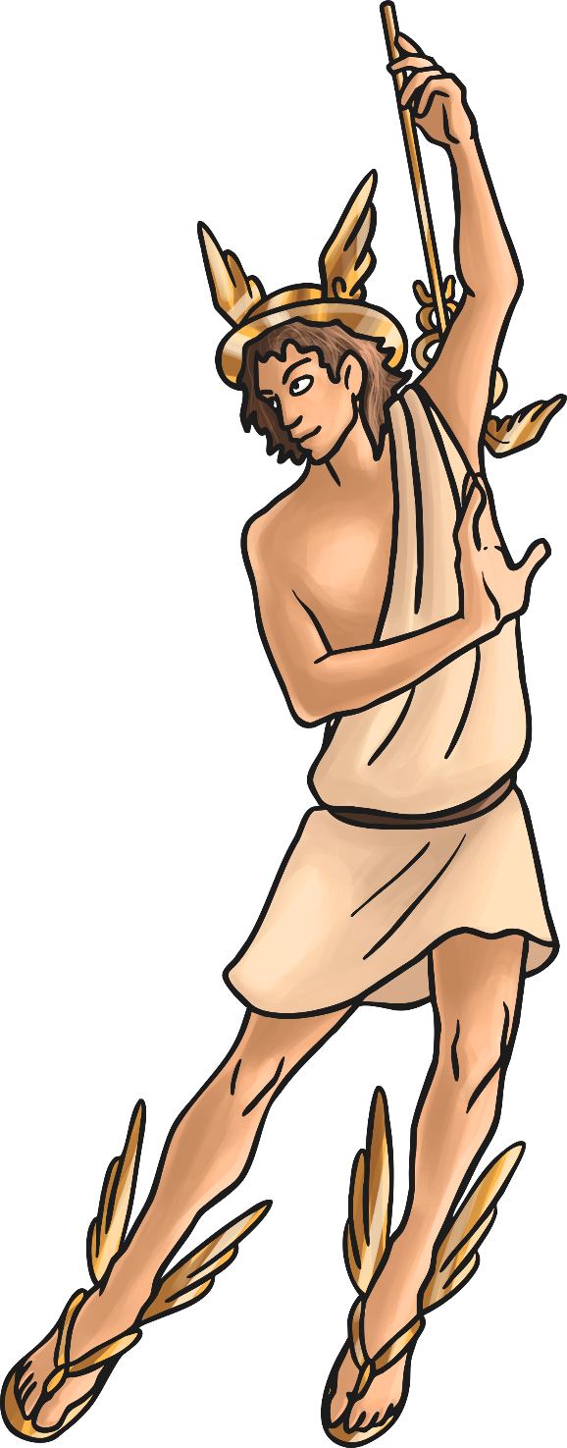

Hermes
Hermes was Zeus’s youngest son.
Hermes was very fast on his feet and very clever, so Zeus decided to make him a messenger.
Hermes always knew everything that was going on in the mythical world.
The other gods trusted Hermes. He was very clever and loyal, and he was a good negotiator.
Did you know?
Many Ancient Greeks believed that Hermes was responsible for the invention of the alphabet, boxing and gymnastics.

Slide 16
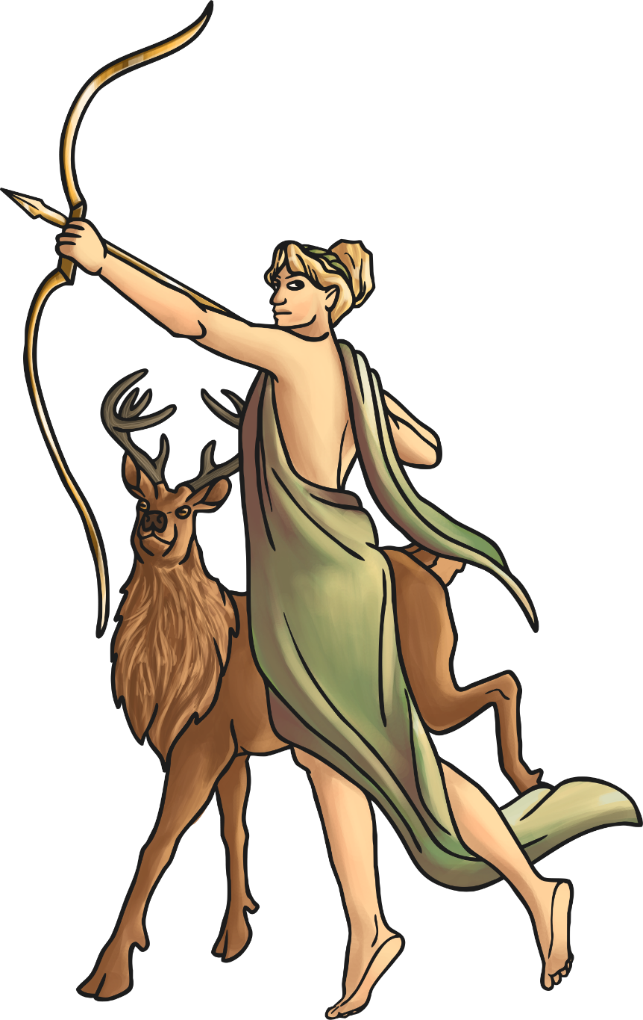
Artemis
Artemis was the daughter of Zeus and the twin sister of Apollo.
She was a moon goddess, responsible for the movement of the moon across the sky at night.
She moved the moon in a chariot pulled by stags.
She was also a huntress and the protector of animals and young children.
Did you know?
A hunter was caught spying on Artemis when she was bathing. As punishment, Artemis turned him into a stag and set his own hunting dogs on him.

Slide 17


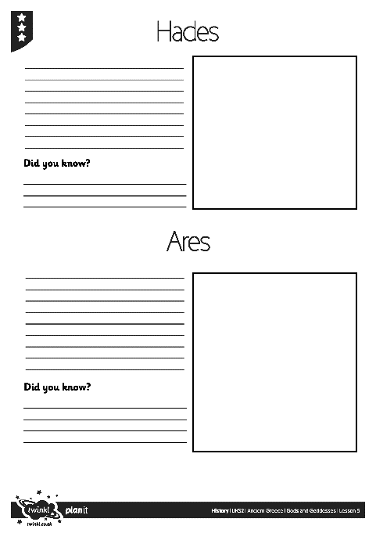
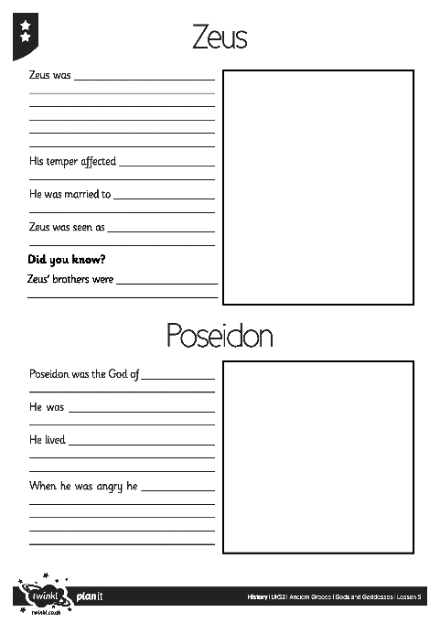
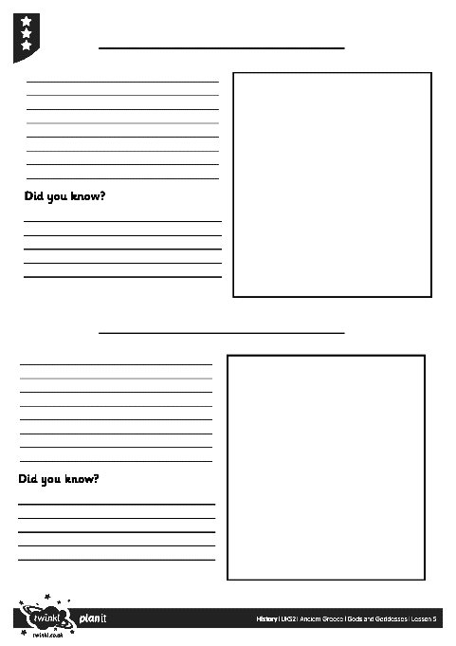
Fact Files
Complete the Greek Gods Fact File to show what you have learnt about the different Greek gods and goddesses.

Slide 18

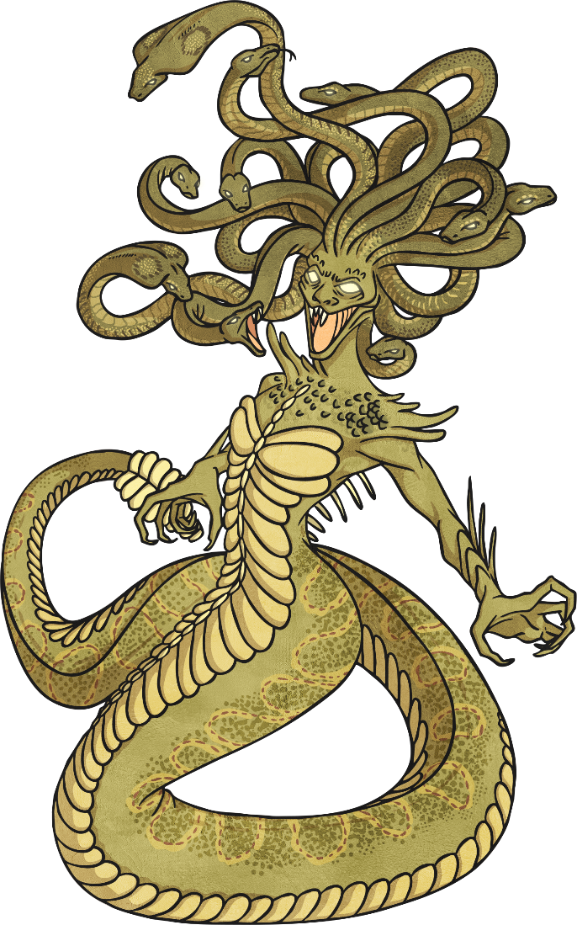
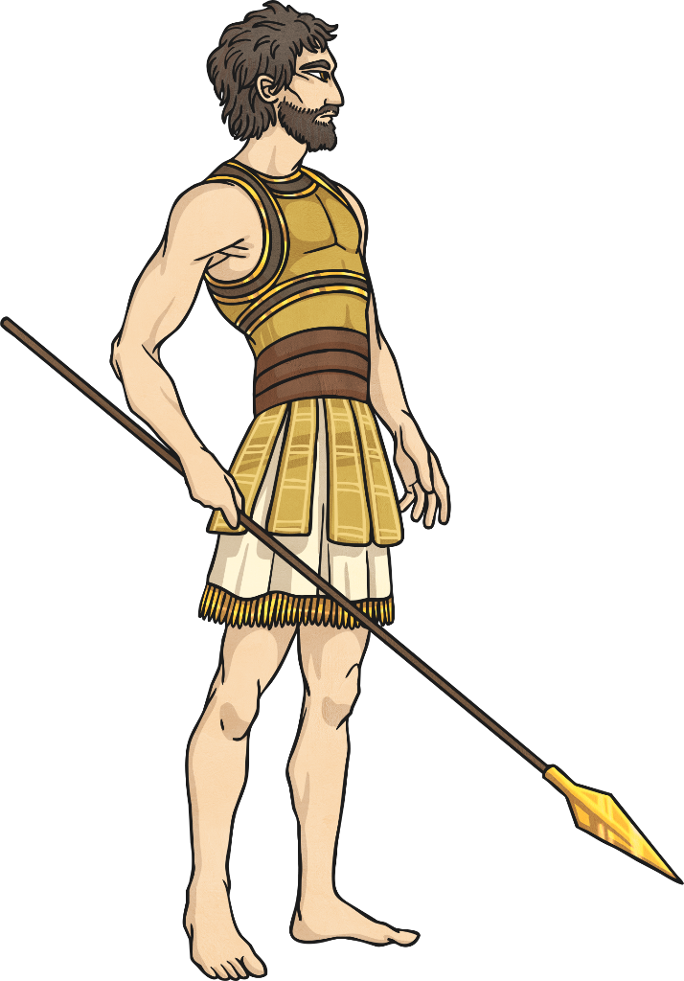
Myths and Legends
The Ancient Greek people told many stories featuring their gods and goddesses. Many Greek myths feature scary monsters and tell tales of heroic quests. The stories helped the Ancient Greek people make sense of the world and explained how things came to be.
The stories were passed on Orally as people did not read and write. Over time, the stories became more exciting and scary and the characters became more heroic. They became the legends that we know today!

Slide 19
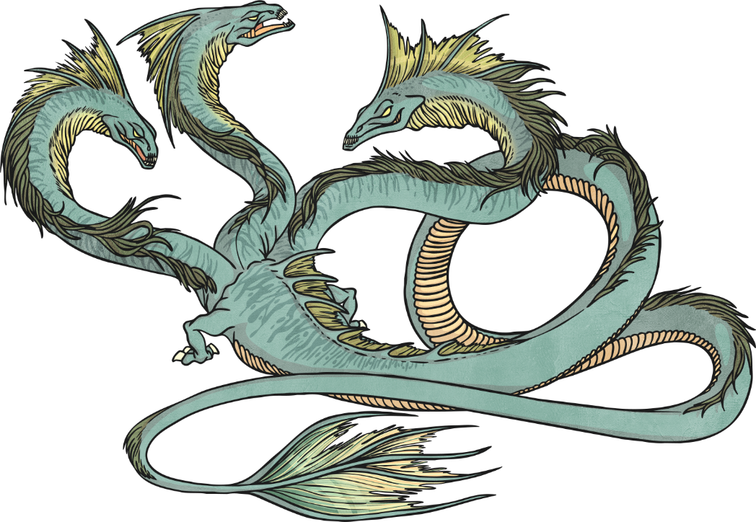
Myths and Legends
What have we learnt about the gods?
What stories have been written about them?
We are now going to plan our own Greek myth!
What should we include?
Who is your hero and what is the setting?
What is the problem or dilemma?
What god/goddess do they meet? How does the god/goddess help them?
What monster do they meet?
How is the problem solved?
How does the story end?

Slide 20
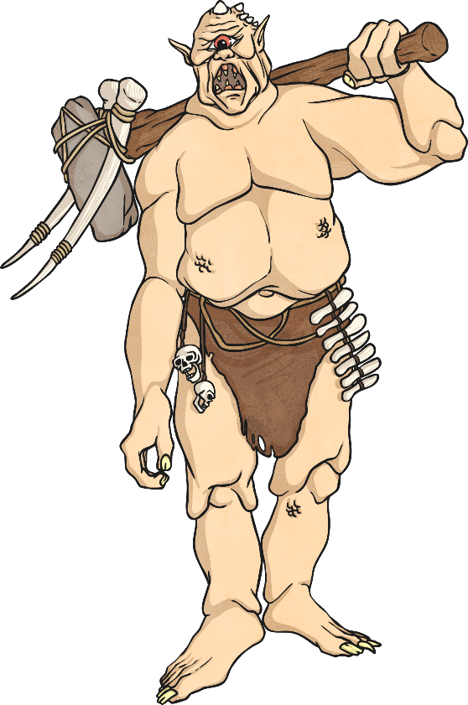
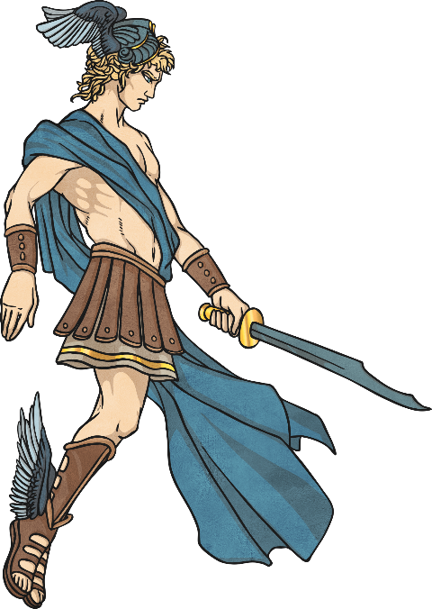
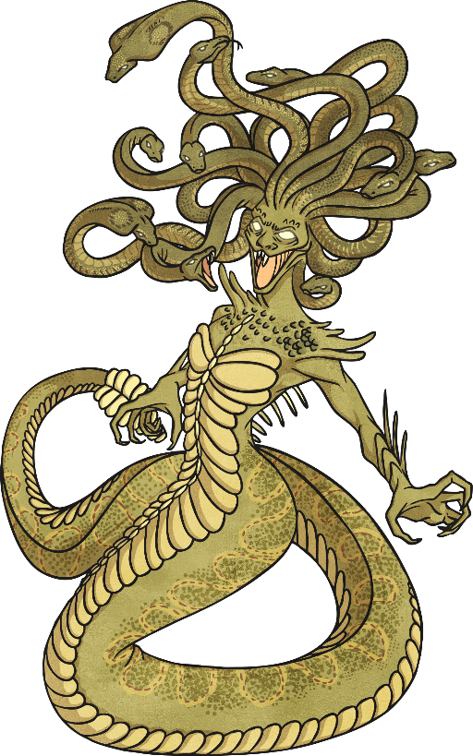
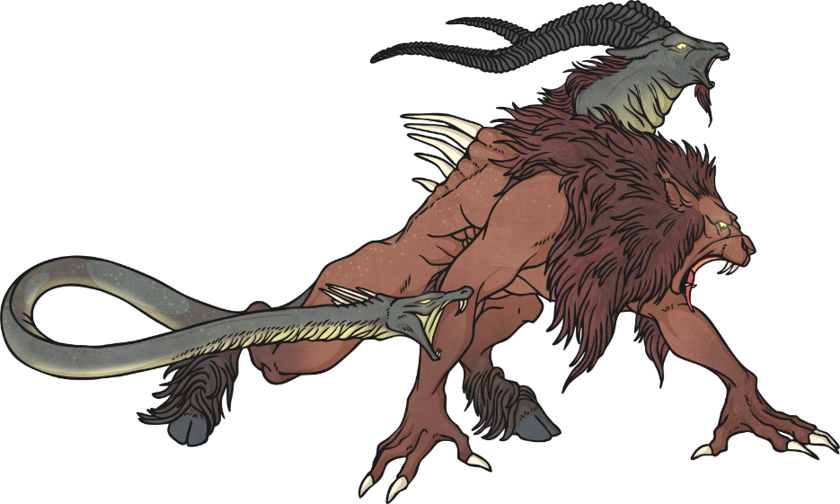
Our Greek Myth
The story dice will give us ideas for the god, setting, monster and hero that we will use.
Let’s roll the dice and see what story ideas we get!

Slide 21

Aim
I can find out about Ancient Greek gods and goddesses and am able to use this knowledge to plan my own Greek myth
Success Criteria
I can research different Greek gods and say key facts about them
I can plan my own Greek myth, using gods, goddesses, monsters and heroes

