Slide 1
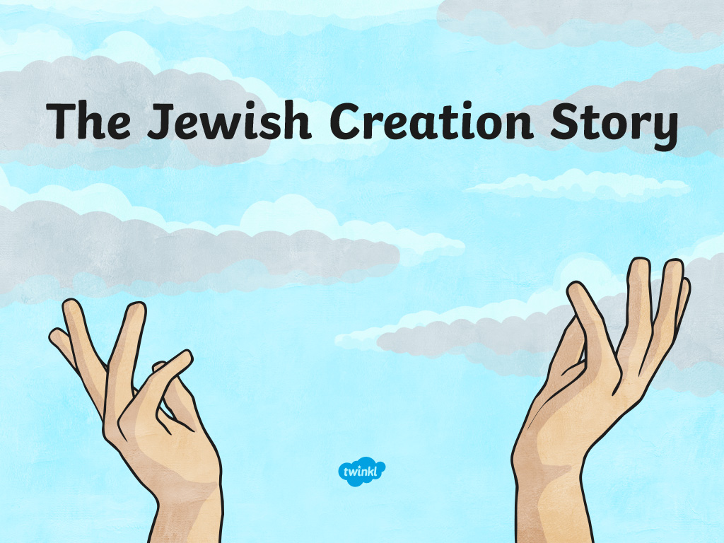

Slide 2
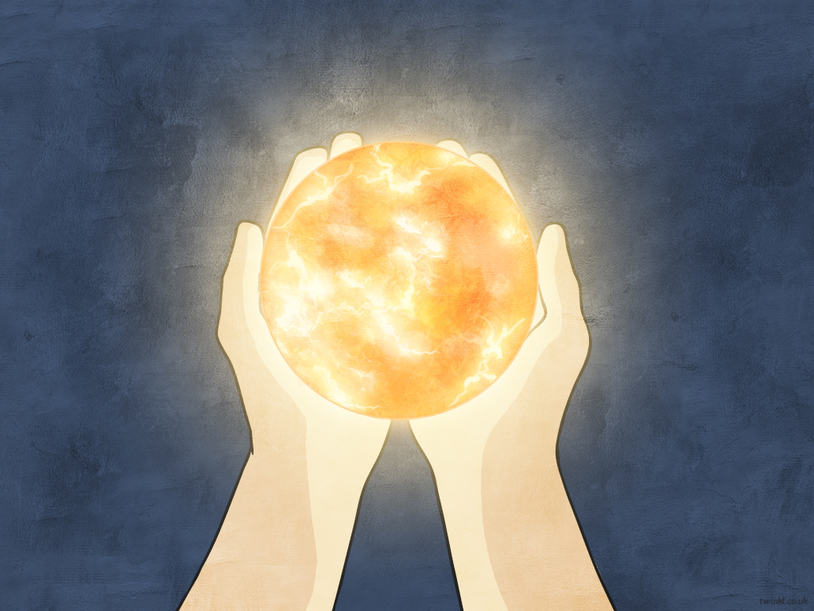
On the first day, God created the heavens and the earth.
He created light and separated it from darkness.

Slide 3
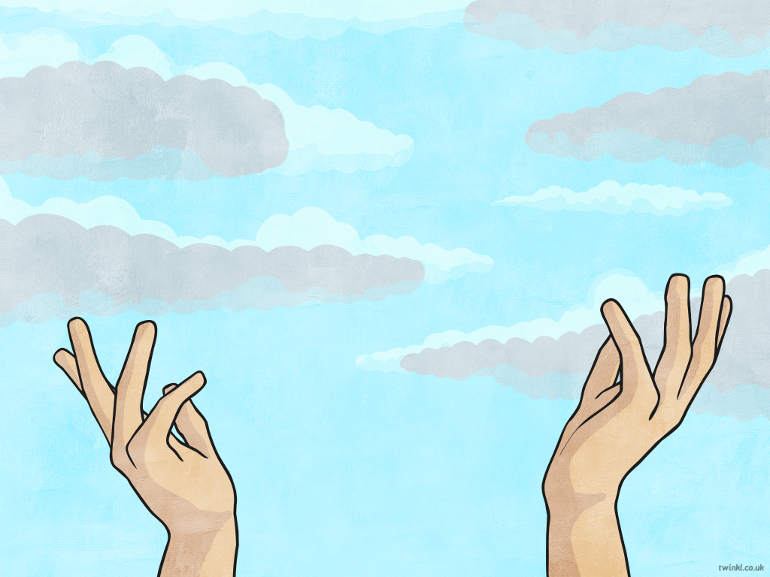
On the second day, God created the sky.

Slide 4
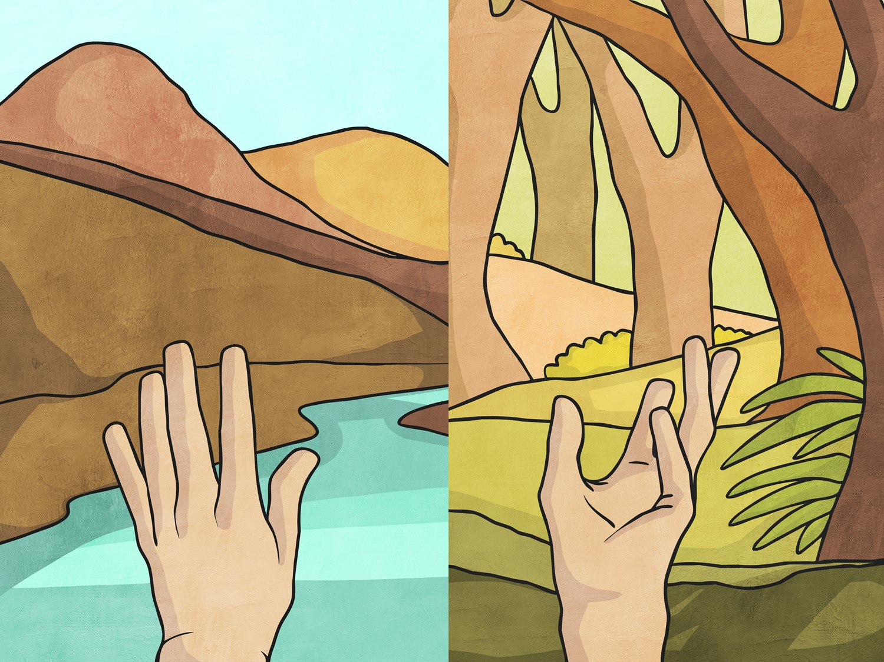
On the third day, God separated the land and water and created grass, trees and flowers.

Slide 5
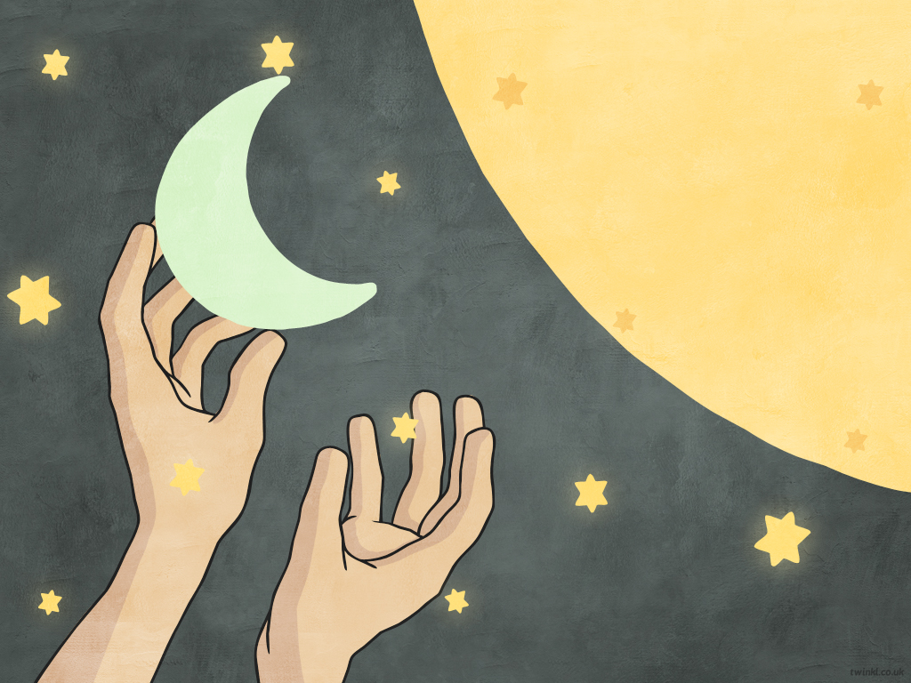
On the fourth day, God created the sun, moon and stars.

Slide 6
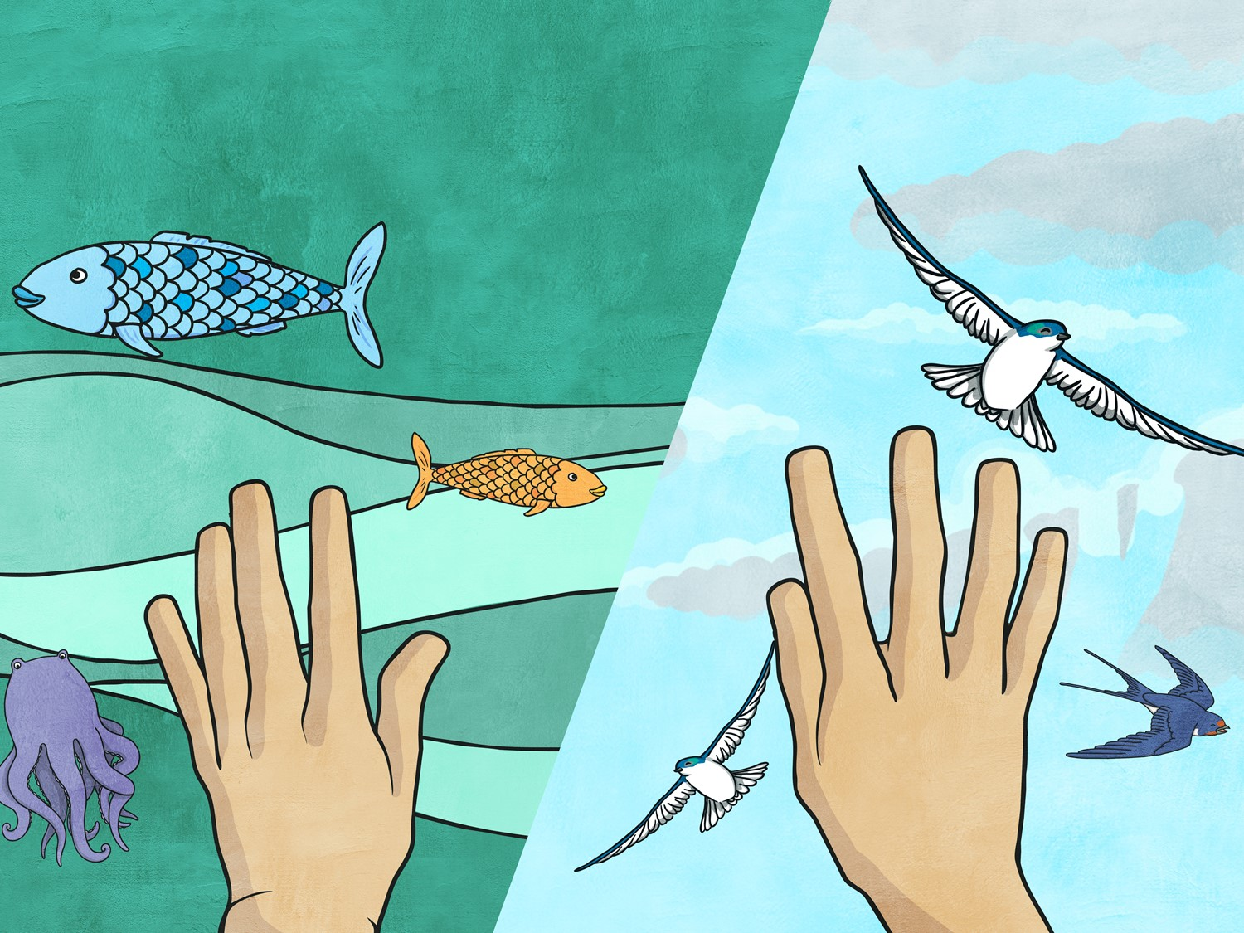
On the fifth day, God filled the seas with fish and other water animals, and He filled the sky with birds.

Slide 7
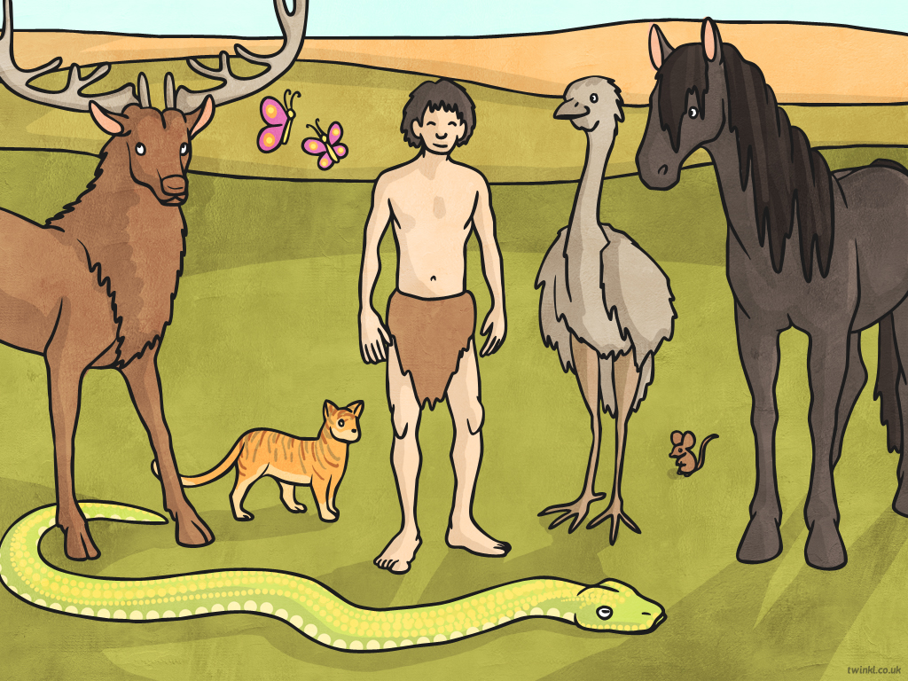
On the sixth day, God created all the other animals.
He also created man and gave him great mental ability.
God also gave man the power of speech and the responsibility
to look after the animals on Earth.

Slide 8
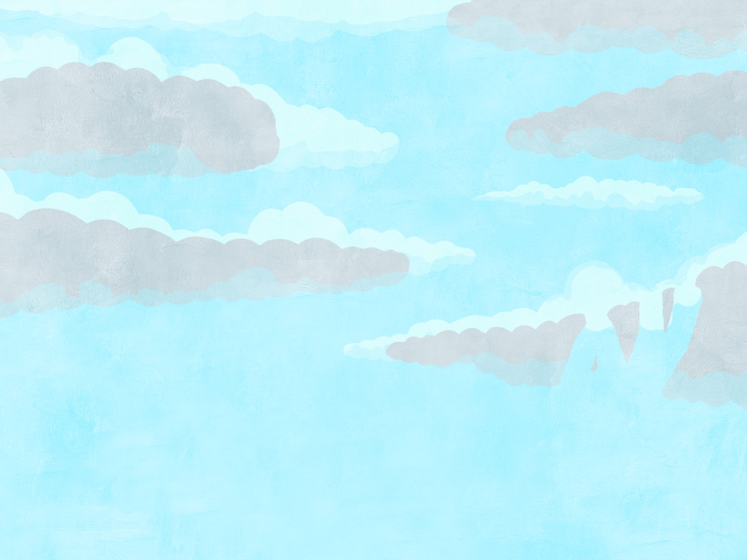
On the seventh day, everything was created and God rested. Jews believe that they should work for six days and rest on the seventh day, Shabbat. By doing this, Jews show that they believe in God as the creator of the world.

