Slide 1
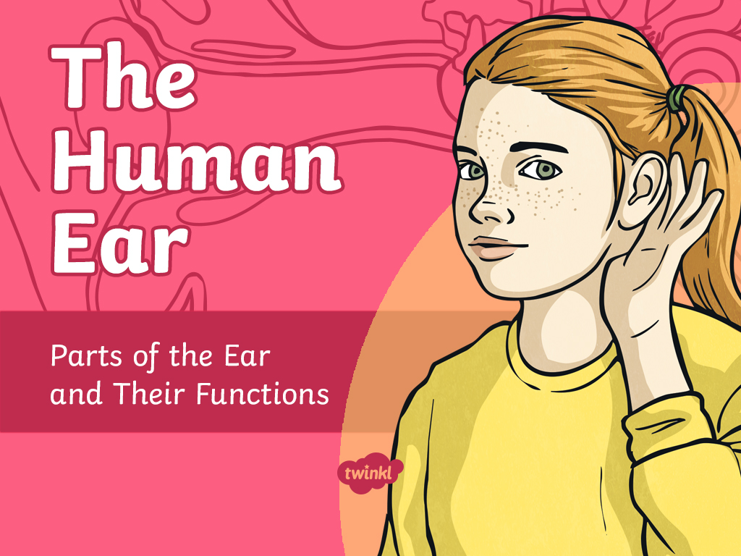

Slide 2
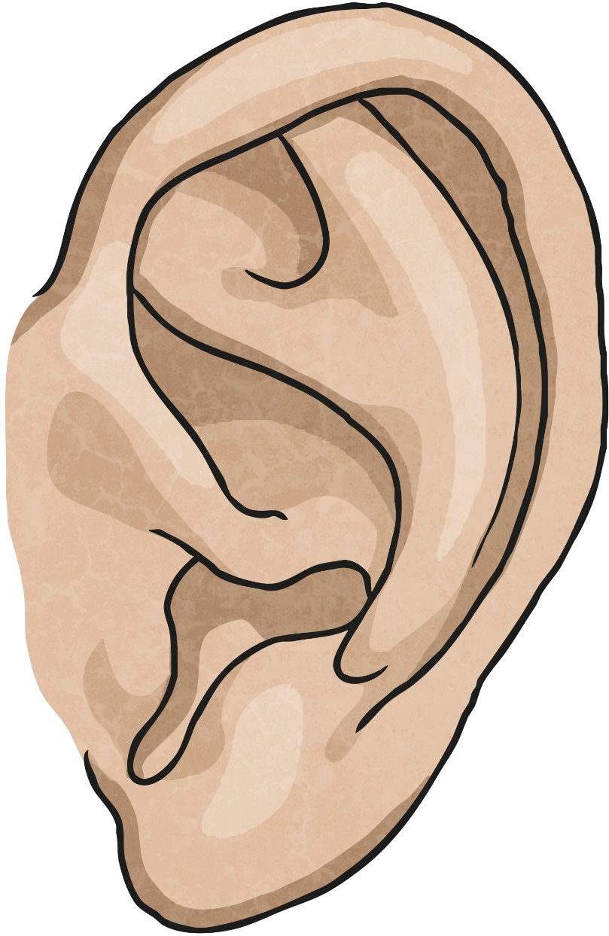
Our Ears
The human ear is incredible! Ears can sense sound in the form of vibrations and send and receive signals from the brain.

Slide 3
Look Closely
Look closely at a partner’s ear.
You will be able to see the outer structure of the ear.
Take a minute to describe to your partner what you can see.
Click here to start the timer!
We are going to find out about the parts of the ear we can see and the ones we cannot. We will also learn what each part's function.

Slide 4
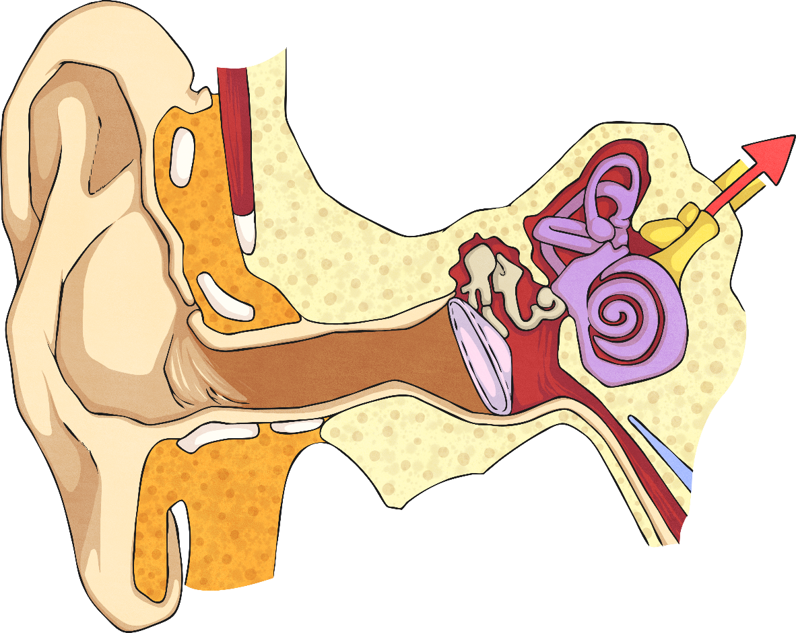
Pinna
The pinna is made of cartilage covered by skin.
It funnels sound into the ear canal.

Slide 5
Ear Canal
The ear canal is a short tube that transmits sound
from the pinna to the eardrum.

Slide 6
Eardrum
The eardrum is a thin, tough layer of tissue at the end of
the auditory canal. Sound waves make the eardrum vibrate.

Slide 7
Ear Bones
Ear bones, or ossicles, are three tiny bones that amplify and
transmit the vibrations from the eardrum to the cochlea.

Slide 8
Cochlea
The cochlea is an organ filled with fluid. Receptor cells change vibrations in the fluid into electrical impulses.

Slide 9
Auditory Nerve
The auditory nerve contains sensory neurons that
send information to the brain for processing.

Slide 10
Eustachian Tube
The Eustachian tube connects the middle ear to the nasal cavity.
It regulates the pressure within the ear.

